Slide 1
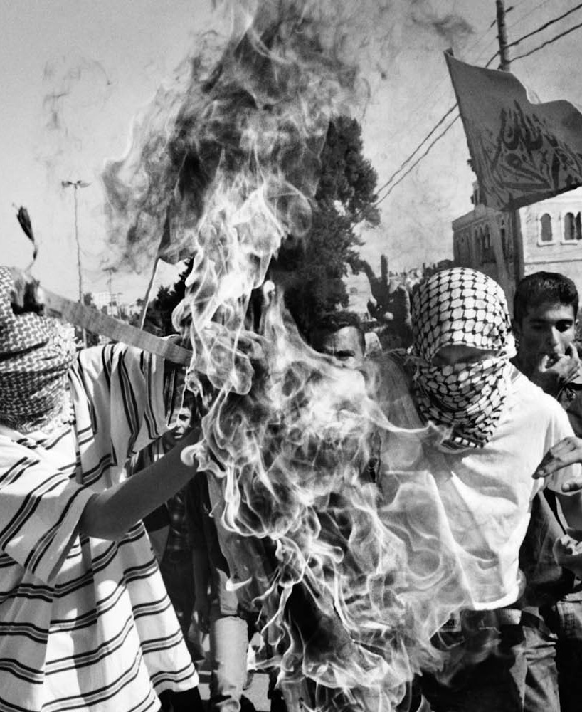

Palestinian Terrorism
Deep dive into 50 years of terror
By Yves Kreimerman & Shahaf Pinto

Slide 2
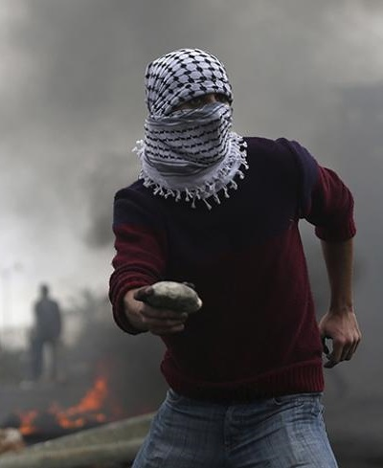
What are the main trends in terror attacks over the years? How can we prevent the next attack?
Background
Information
To answer such question, we first need to understand what motivates terror attacks:
01
02
Palestinian Nationalism
Religion
Keeping the Palestinian Ideology alive
Fight over holy sites and land(Jerusalem)
03
04
Politics
Economics
Undermining and discrediting the enemy government by hurting the home front
30% Of all population is in poverty, foreign country provocation
Motives, Methods and everything in between

Slide 3
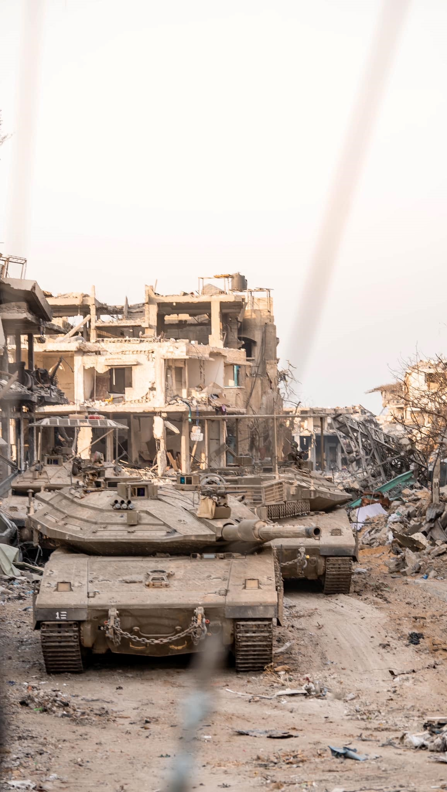
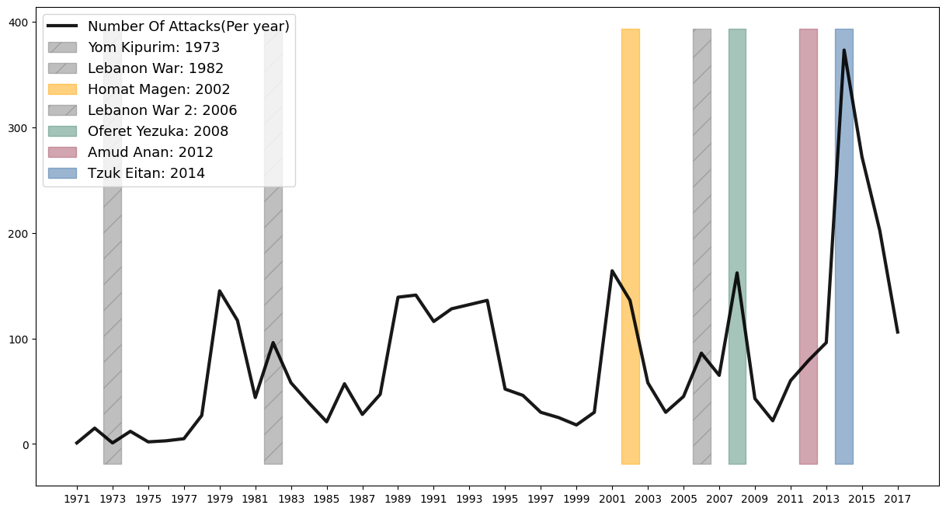
Average Number Of Attacks During Israeli Wars
Patterns
Pattern:
Wars
Israeli Wars
All Terror waves usually come in a frequency of 2 years. The bigger ones are leading to war/operation.
How do wars effect terror waves?

Slide 4
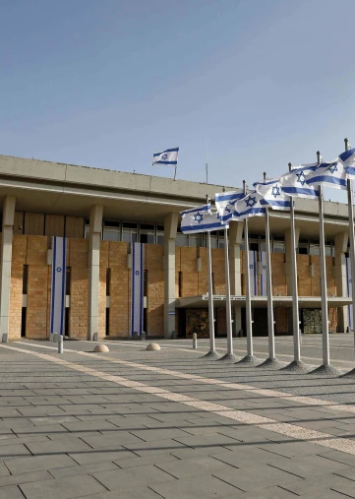
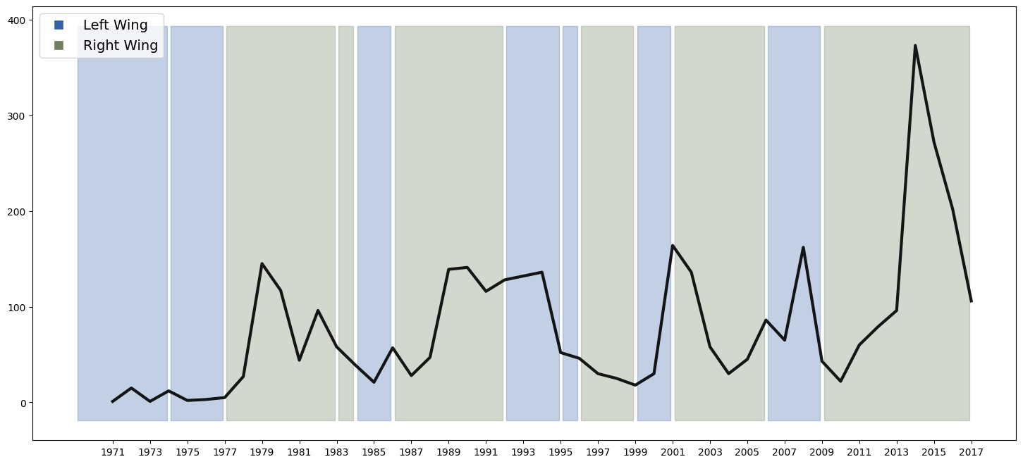
Number Of Attacks Under Different Governments
Patterns
Government Wing
We can see more significant terror spikes under Right-Wing governments.
How do government wing effect terror waves?

Slide 5
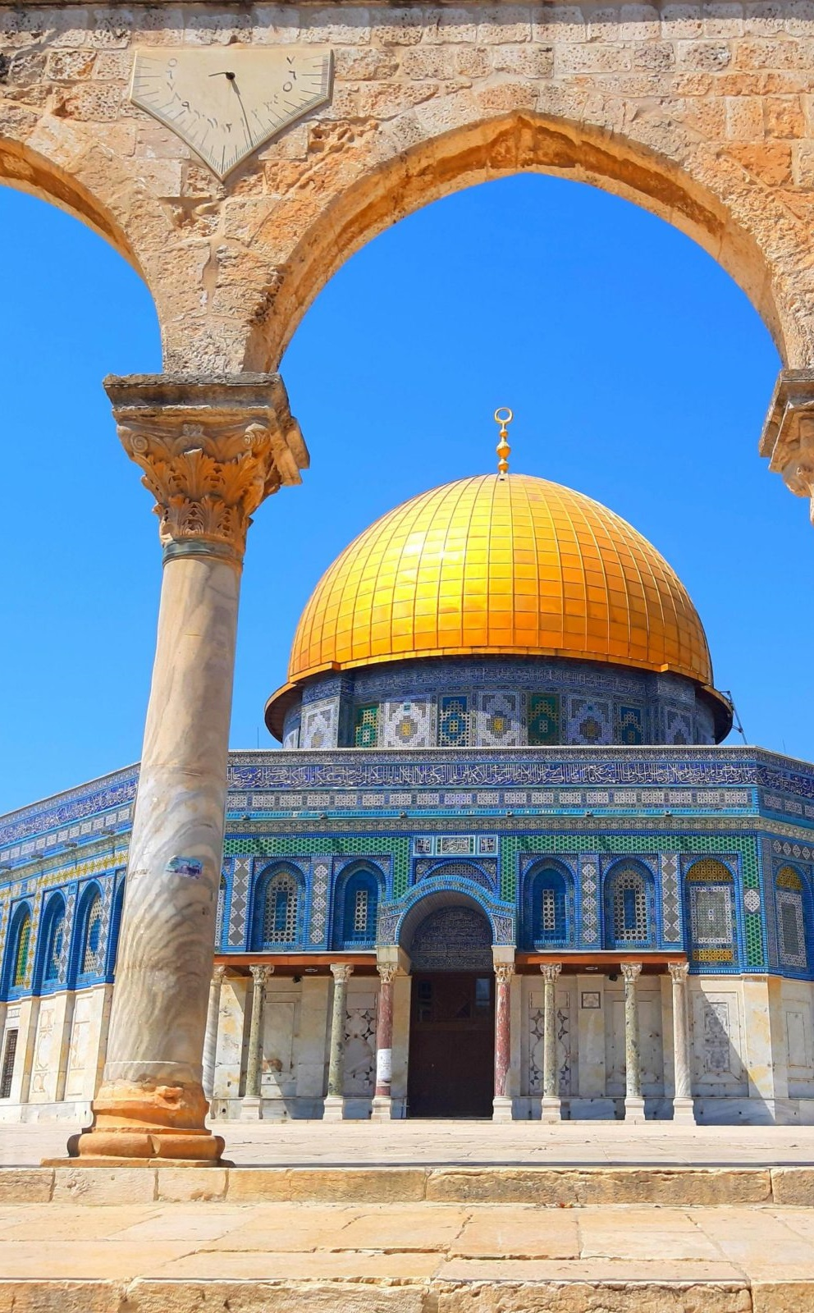
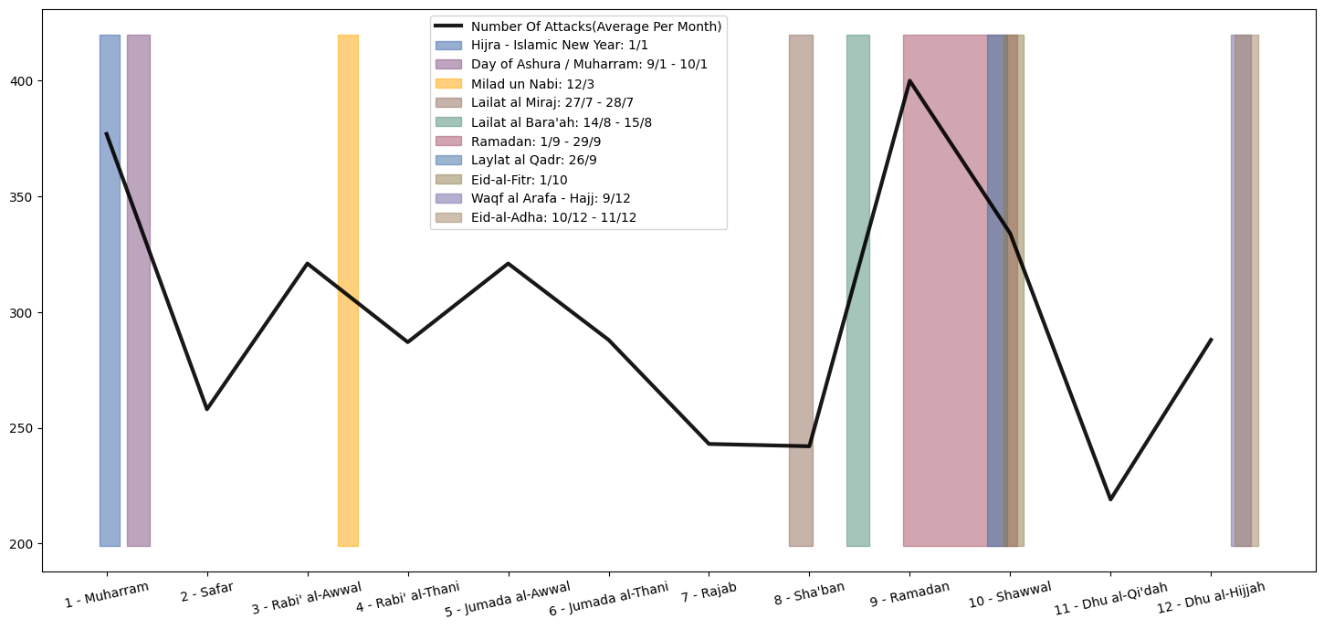
Average Number Of Attacks During Islamic Holidays
Patterns
Islamic Holidays
We can a significant spike in terror from the end of “Lailat Al Miraj” up to the end of “Eid Al Fitr”, Mainly around the Temple Mount area.
How do Islamic Holidays effect terror waves?

Slide 6
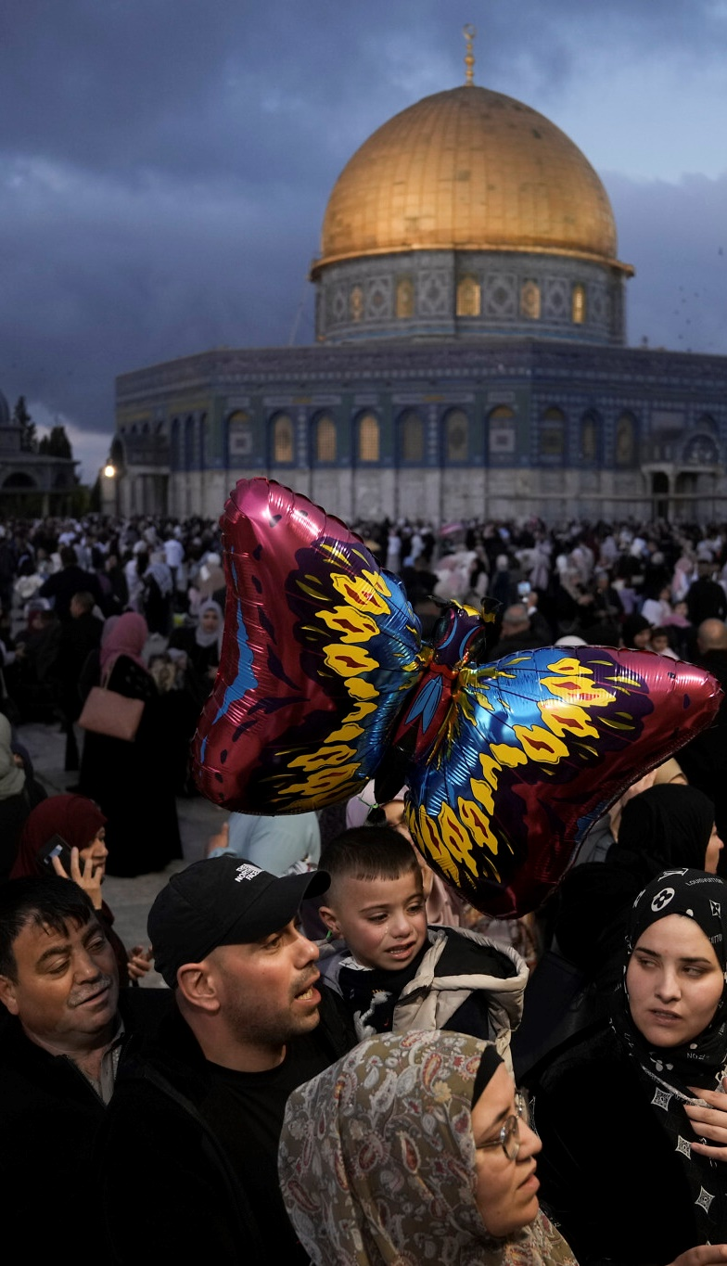
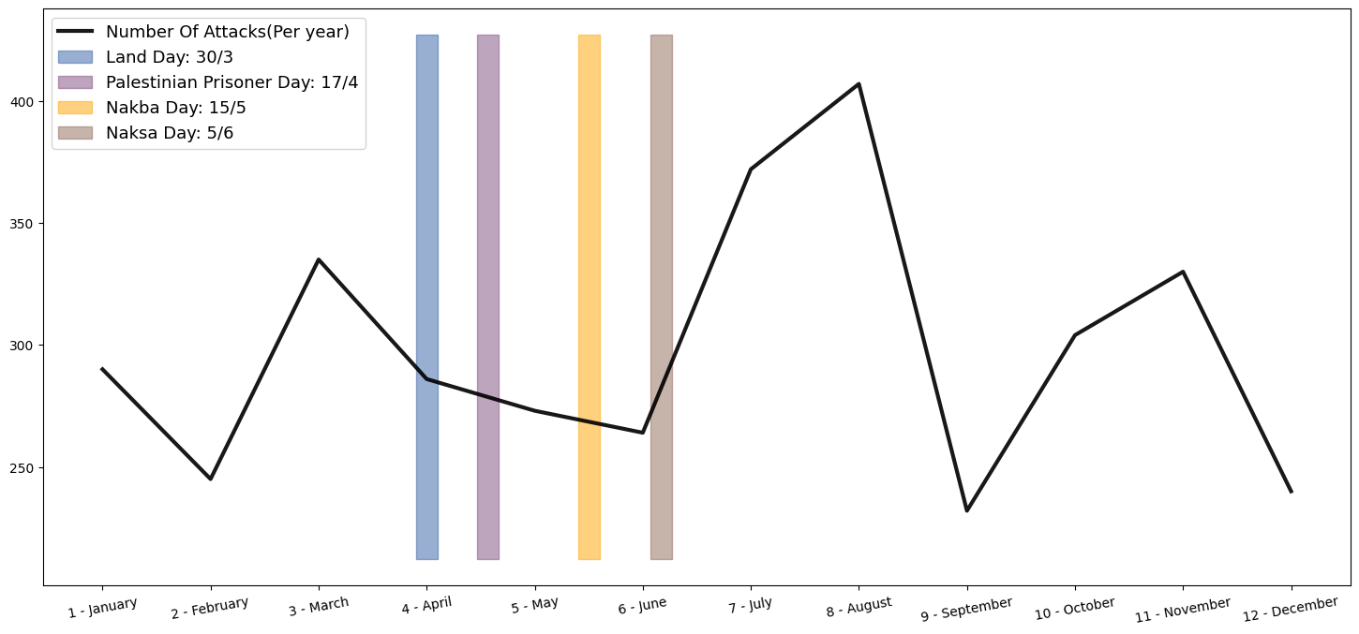
Average Number Of Attacks During Islamic Holidays
Patterns
Palestinian Holidays
We can clearly see a significant peak in terror right after the “Naksa Day”, Lasting for around 2 months on average.
How do Palestinian Holidays effect terror waves?

Slide 7
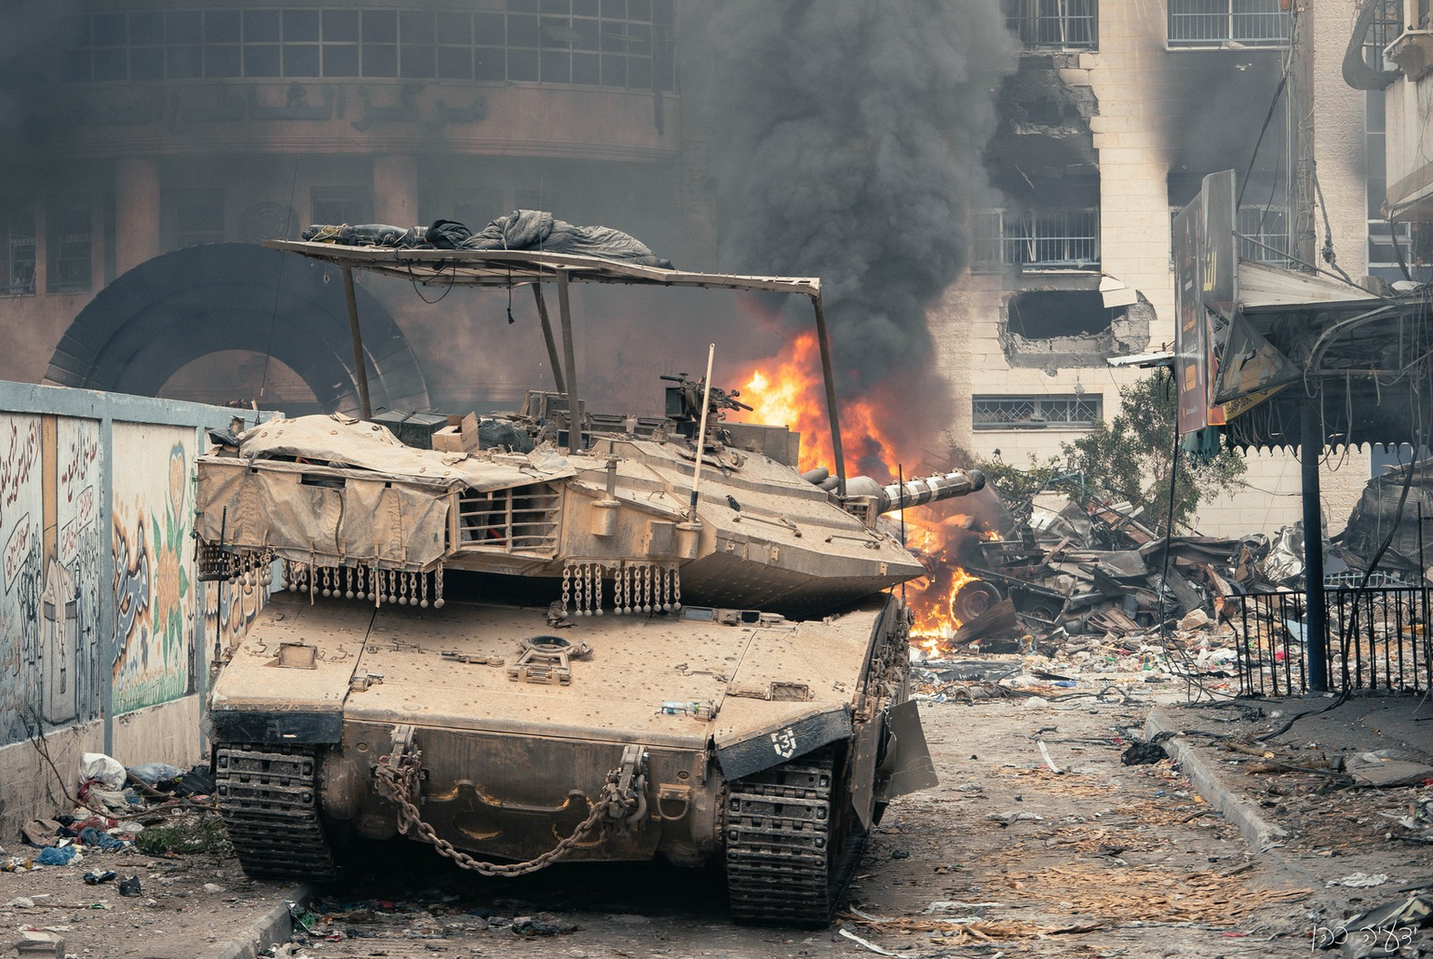
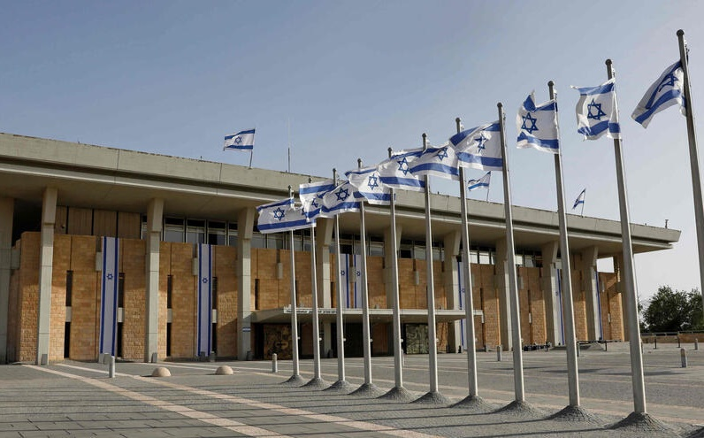
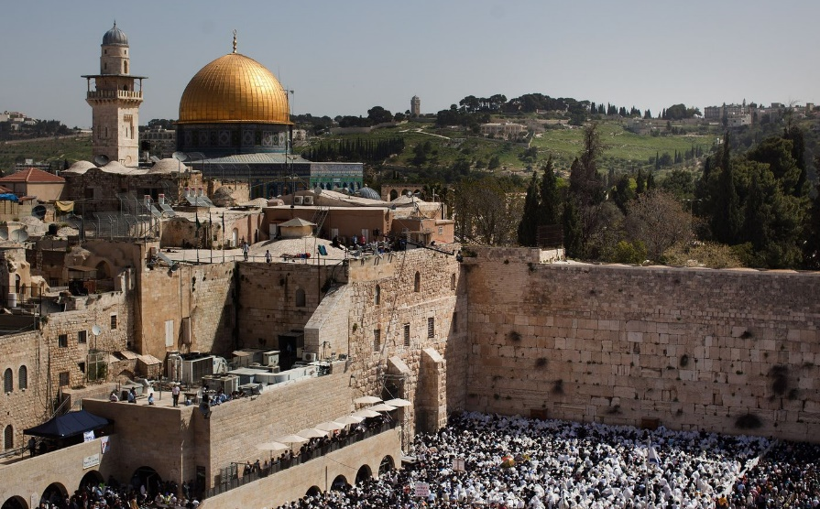
War
War has a very strong effect on ending terror spikes. Majority of wars come as a response to a terror wave and bring relative quiet to 2-4 years.
Key Takeouts So Far…
Government Rule
Right-Wing Governments under which Palestinians are being subjected to more Economic and Territorial laws, have 122% more terror attacks on average per year.
Holidays
Holidays leading to Ramadan have a an average growth of 50% in terror attacks. We can see The same spike at the end of “Naksa Day”.

Slide 8
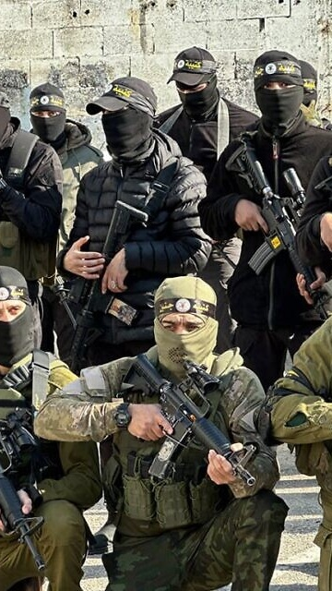
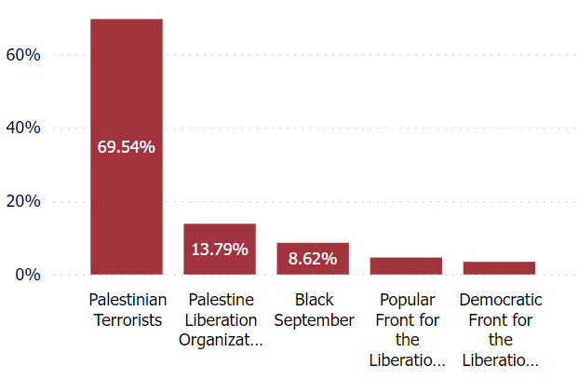
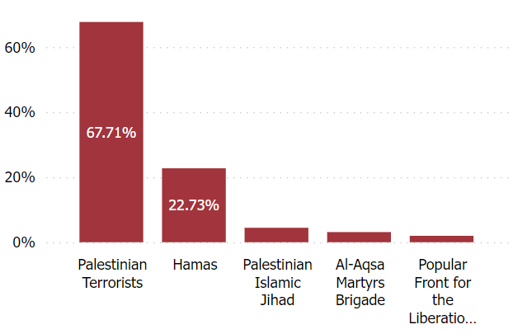
1970’s VS 2010’s – Group Association
1970s
2010s
Distributions
Group Association
Individual Palestinians consistently make the majority of terror attacks, with the main terror organization evolving over time.
How do Palestinian Holidays effect terror waves?

Slide 9
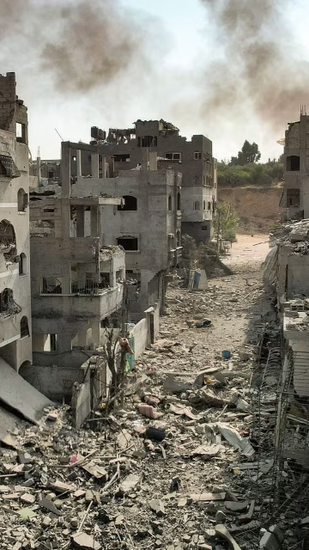
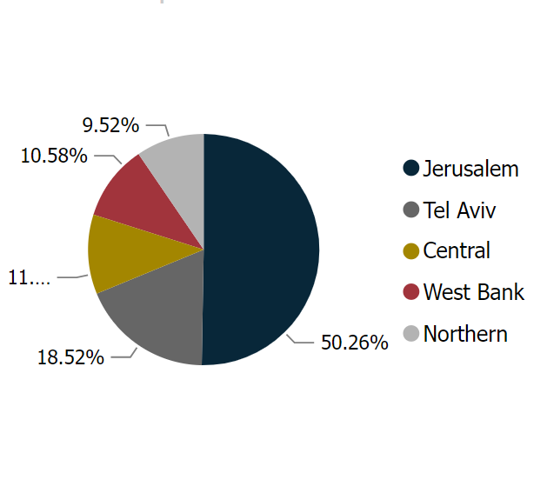
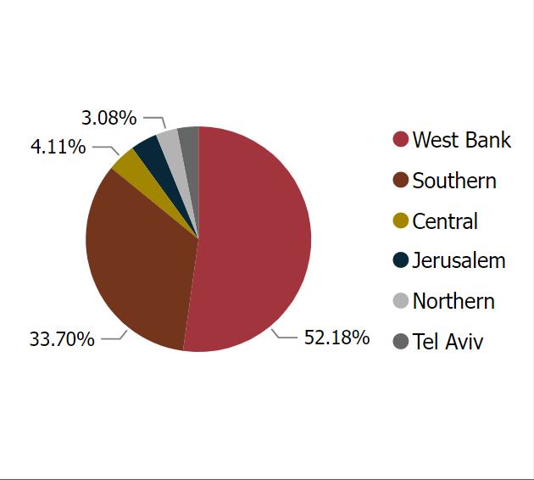
1970’s VS 2010’s – Place Of Attack
1970s
2010s
Distributions
Place Of Attack
We can see a significant increase in the terror attacks in the west bank and in southern Israel.
How do Palestinian Holidays effect terror waves?

Slide 10
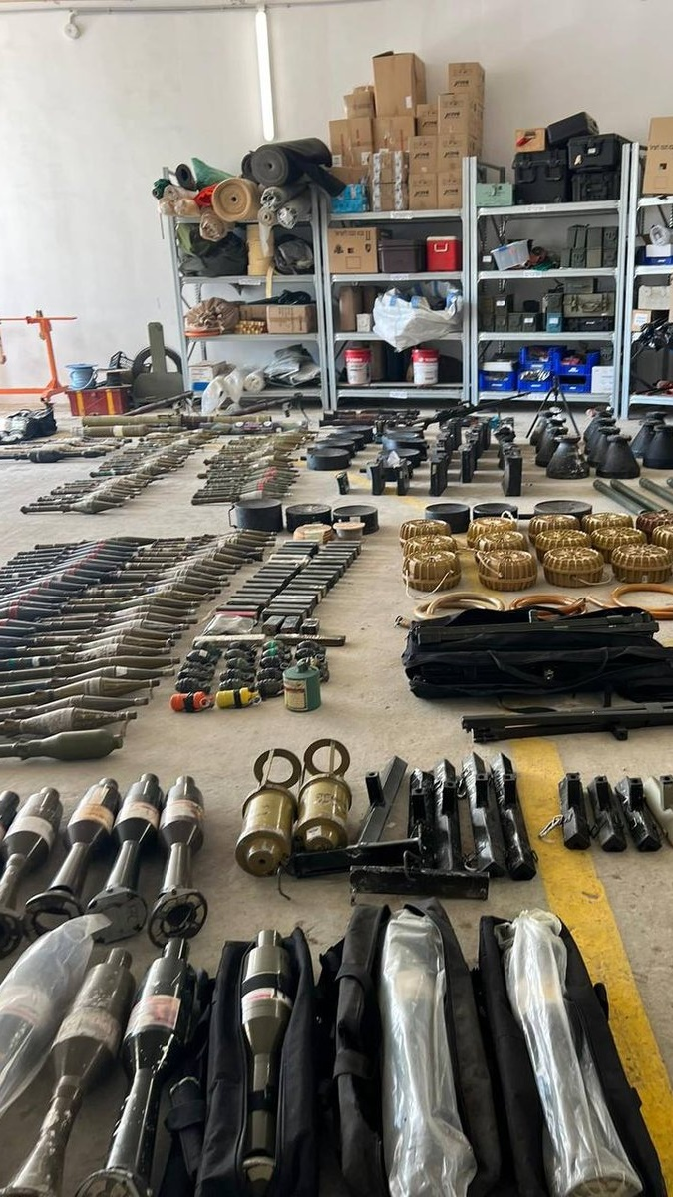
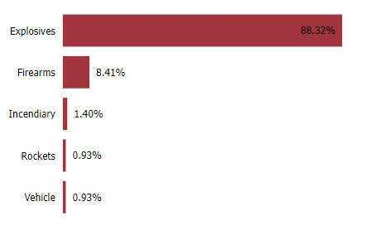
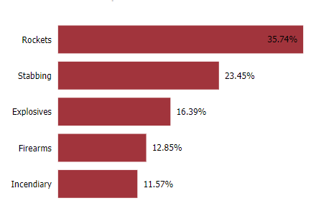
1970’s VS 2010’s – Weapon Used
1970s
2010s
Distributions
88.32%
Weapon Of Attack
35.74%
We can see a shift from mostly explosives to a rise in use of rockets, stabbing, firearms, and incendiary attacks.

Slide 11
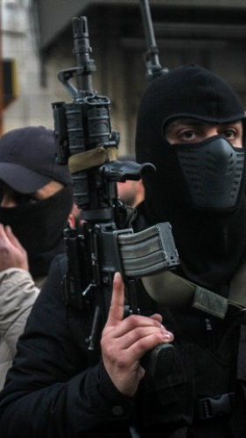
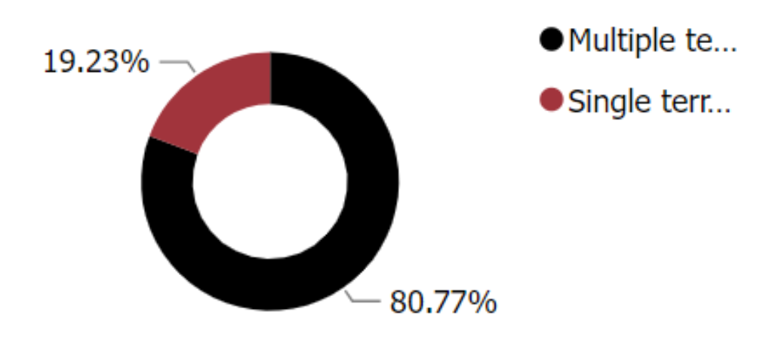
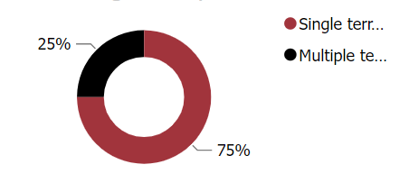
1970’s VS 2010’s – Individual VS multiple terrorists
1970s
2010s
Distributions
Individual Count
In the past, terror attacks involved multiple individuals, but today, single terrorists are more common.
How do Palestinian Holidays effect terror waves?

Slide 12
Let’s Interact With Some Data…

Slide 13
To Sum It Up - Conclusions
01
02
03
04
Religion Plays A Major Role
Poverty As Key For Terrorism – Or is it?
Rise Of Individual Terrorism
It All Comes Down To Education
We saw clear evidence of both holidays and national Palestinian days having a part in the rise of terror waves. The IDF must have serious preparation for those, including having more military personnel around religious sites(Temple Mount).
Despite the conception that poverty can be of motivation to terrorism, statistical evidence show little to no evidence to support the claim. With more Palestinian Workers permitted to work in Israel, terror waves have no signs of calming, but on the contrary.
We see a significant spike in terrorism as individuals rather than in terror Organizations, mostly in the West Bank. Must prevent grouping in the West Bank at all costs.
We saw Palestinians choosing Hamas in the Gaza Strip democratic elections in 2006, wiping all changes hoped to achieve in the Oslo agreements. Preventing terror must begin with proper and right education for the younger Palestinian generation.

Slide 14
Thank You!

